Slide 1
WBL_GOES_VIRTUAL Training Programme
Module 4 Hands-on Practice

Slide 2
AGENDA
Select WBL learning content for virtualisation
Define learning goals / learning outcomes
Best & Worst Case Examples → Identify success criteria
Create storyboard & red thread + call to action
Choose most suitable delivery method
Create, upload, livestream videos
Choose virtual assessment tools
Overview of Self-Directed Learning phase
Please note:
In this session, you will try the methods in a small scope.
You can put all you have learned into practice in the SDL phase!

Slide 3
SELECT WBL LEARNING CONTENT
Choose suitable learning content for virtualisation

Slide 4
CHOOSE YOUR CONTENT
PAIR WORK
Which of your WBL topics do you want to digitalise? (collect on flipchart)
Are they suitable for virtual presentation?
What possibilities do you think you have in a digital context?
What challenges could arise?
DISCUSS

Slide 5
DEFINE LEARNING GOALS
Set the aim which the learners should achieve

Slide 6
LEARNING GOALS
To make WBL learning content accessible virtually, it should be divided in smaller learning chunks.
Separate the content by thinking of small learning milestones that lead to the final learning goal
Ask yourself: What should the learner know or be able to do after they finish the learning session?
Make sure: Is the goal achievable in the available amount of time? If not, can you define even smaller learning milestones?

Slide 7
LEARNING GOALS
Knowledge
Skills
Competences
Theoretical concepts & fact-based understanding
Putting theory to practice, implementation of tasks, display of practical abilities
Applying knowledge and skills in practice autonomously
Notes:
For more info about learning outcomes, follow the link: https://www.cedefop.europa.eu/files/4156_en.pdf

Slide 8
DEFINING LEARNING GOALS
Structure according to CEDEFOP:
Verbs
Crucial for defining learning goals
Use Blooms Taxonomy → Great free handout at Foundation Online Learning
THE LEARNER
ACTION/VERB
OBJECT
CONTEXT
e.g.:
The learner will be able to
recall
safety measures
within the workplace.
create
evaluate analyse apply understand remember

Slide 9
TRY IT YOURSELF
Create learning outcomes for your WBL content!
TRY IT YOURSELF
10 min
Please share some of your learning outcomes!
Any questions?

Slide 10
IDENTIFY SUCCESS CRITERIA
Best & worst case examples

Slide 11
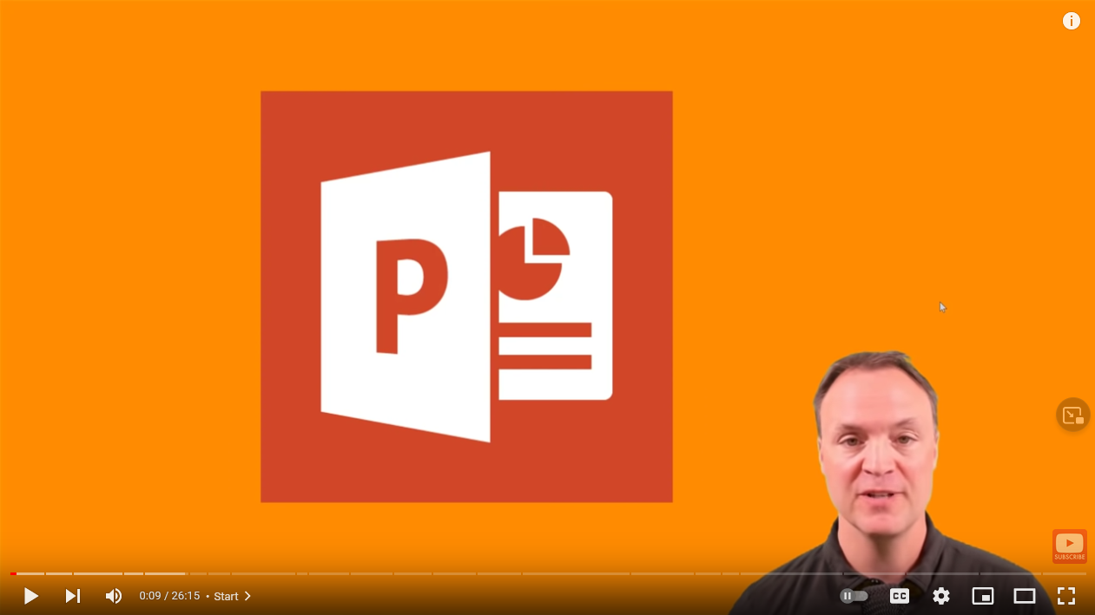
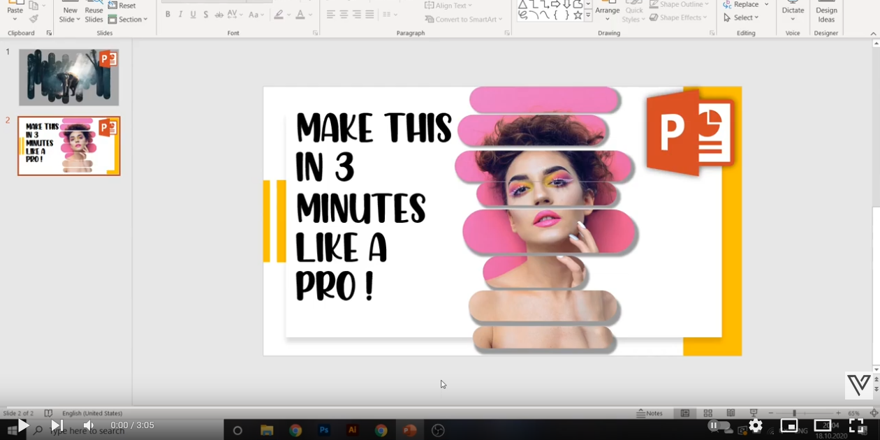
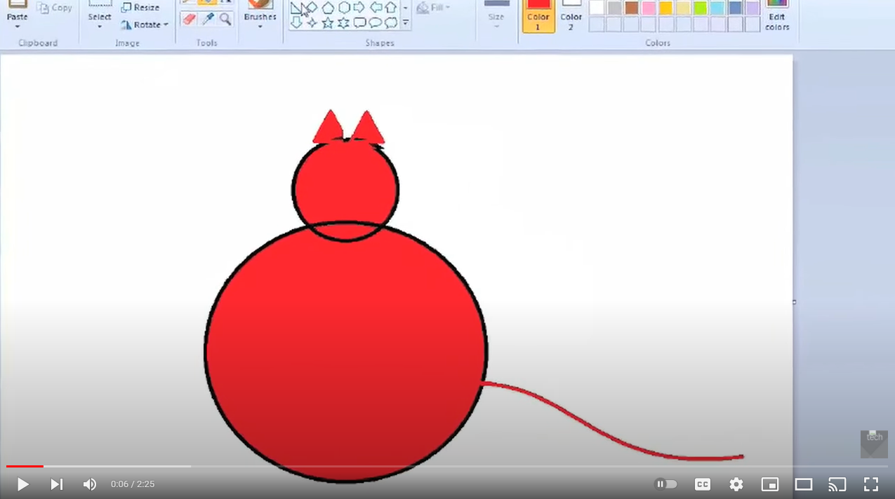
LET‘S WATCH SOME EXAMPLES
Video 1: (only watch 3-5 minutes)
Video 2: (only watch 3-5 minutes)
Bonus Videos:
Notes:
Video 1 shows best practice. Straightforward, to the point, great introduction, clear presentation (e.g. curser visible, starts at zero), coherent from start to finish, and shortcuts/time stamps for easy orientation.
Video 2 shows bad practice. The image and sound is good, however, the intro is too long, too focused on the presenter, a lot of unneccessary information. Bonus video 1 shows bad practice, because there is just loud music, it is not really clear what the goal of the video is and it is very specific to one single task. Bonus video 2 is generally not bad, however the person delivering the tutorial is not competent and not suitable to deliver the content.

Slide 12
WHAT DID YOU NOTICE?
DISCUSS
What makes a good tutorial?
How do you spot a bad tutorial?
Notes:
How to make a terrible tutorial? (https://cgcookie.com/articles/how-to-make-a-terrible-tutorial) *you can also show this to participants*

Slide 13
SUCCESS CRITERIA
5 C‘s
Correct
Clear
Complete
Coherent
Concise
correct facts
good image & sound quality
complete coverage of the topic or chosen segment of a topic
coherent style: a red thread that leads from start to finish
Tell them what you are going to tell them
Tell them
Tell them what you told them
straight and to the point

Slide 14
SUCCESS CRITERIA
visualisation of topic through images, demonstration, visual speech
eye contact (if applicable)
clear processes (e.g. highlighted curser or mouse)
moderate speed (not too quick, not to slow)
engagement through call to action → activate the learners!
Pro Tip: timestamps for easy navigation and repetition (e.g. in YouTube video)

Slide 15
CREATE A STORYBOAD
The red thread that leads through your virtual session

Slide 16
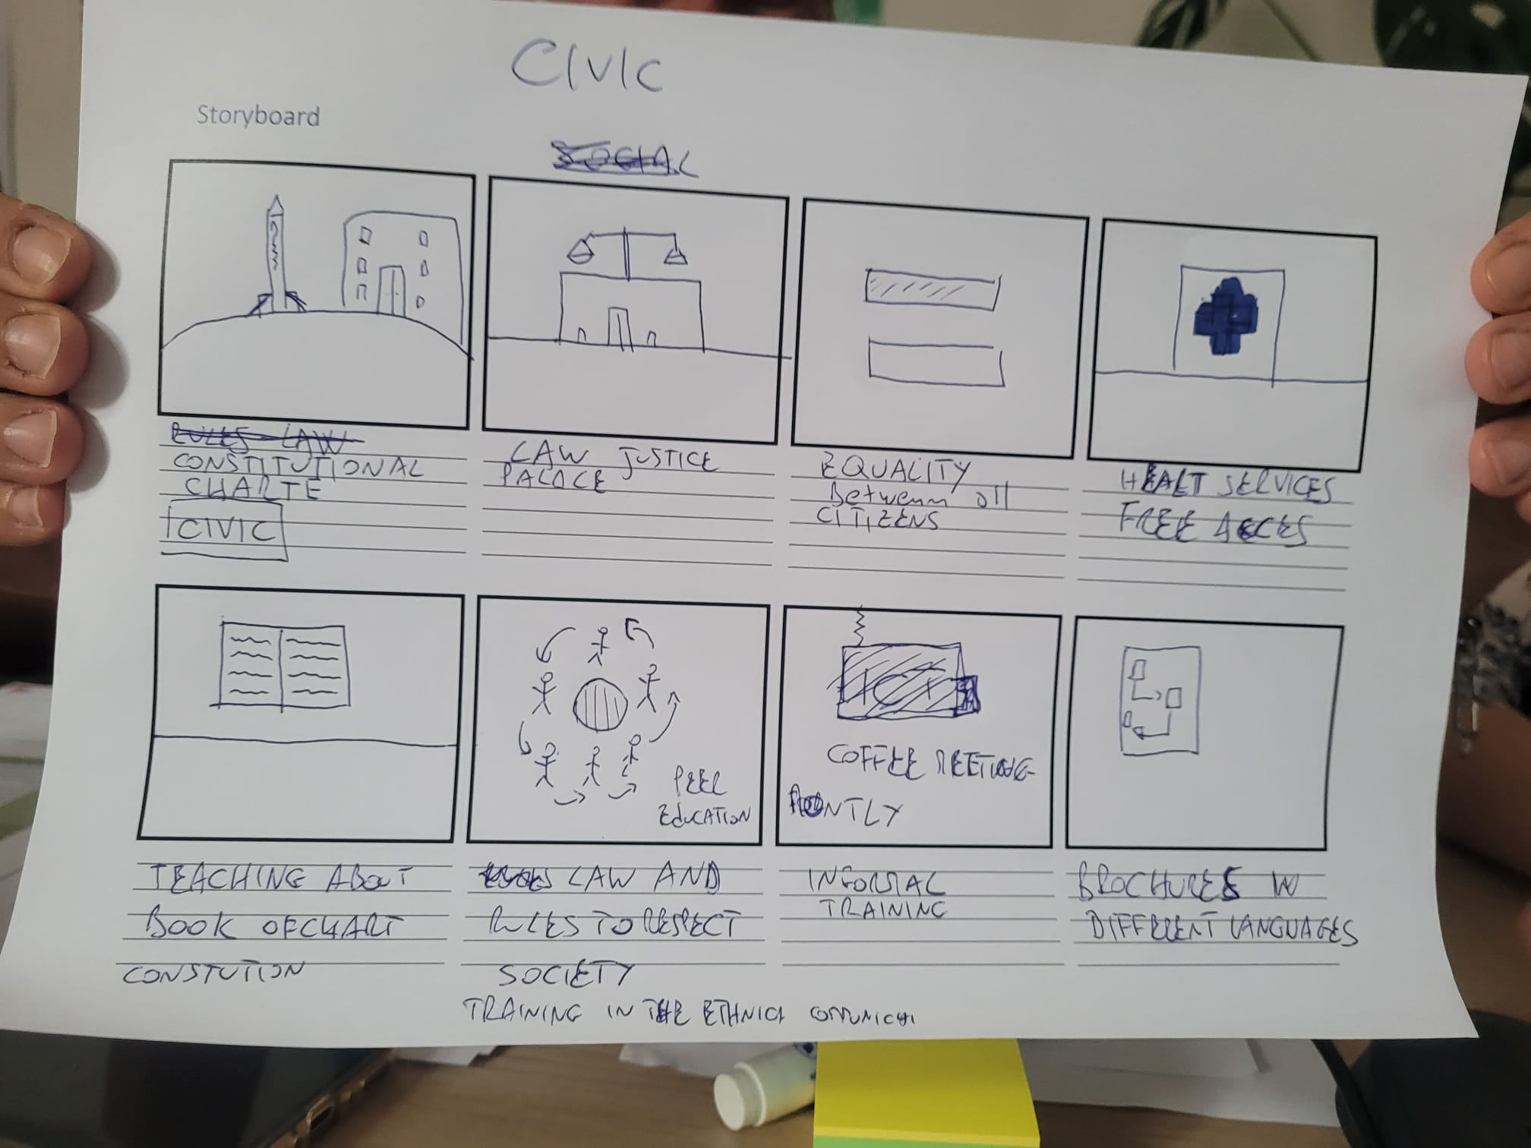
WHAT IS A STORYBOARD?
Step-by-step visualisation of contents

Slide 17
WHY CREATE A STORYBOARD?
Ensure a red thread of purpose throughout the learning content
Introduction & Overview
Tell them what you are going to tell them
Content
Tell them
Summary/Conclusion + Call to action
Tell them what you told them

Slide 18
HOW TO CREATE A STORYBOARD
Think of your WBL content and the learning outcomes and…
start by brainstorming the steps/content to be featured in your digital lesson via a mind map, list, and/or post-its
bring your thoughts in order by numbering/arranging your notes
use a storyboard template to add sketches to your notes
check if you fulfil the 5C success criteria:
Is your session now correct, clear, complete, coherent & concise?

Slide 19
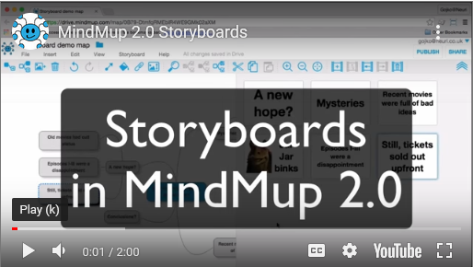
HOW TO CREATE A STORYBOARD
Pen & paper
Powerpoint Slides
Online Tools such as Mindmup https://www.mindmup.com/tutorials/storyboard.html

Slide 20
WHAT IS A CALL TO ACTION?
Activate your learners
Transform them from passive consumer of content to active participant
Engage them to discover and immerse themselves in the content
In a nutshell: Ask them to do something!
research more information
summarise information
put theory into practice
ask questions, write comments, get in touch with you or others (e.g. group work, discussion)
finish with a quiz or assessment (this can be a separate step, too)

Slide 21
TRY IT YOURSELF
Create a storyboard sketch for your WBL content!
TRY IT YOURSELF
20 min
Any questions? Did you encounter any difficulties? Anything you would like to share?

Slide 22
CHOOSE DELIVERY METHOD
How are you going to transport your content?

Slide 23
BRAINSTORM
Which online tools and digital software come to your mind?
DISCUSS

Slide 24
DELIVERY SETTINGS
Synchronous
face-to-face (F2F)
blended/hybrid (some participants F2F, some virtually)
virtual meeting (e.g. Zoom, MS Teams, Google Hangouts)
Asynchronous
trainer gives input & task, learners implement task on their own
call to action via email, learning management system, etc.
learners hand in assignments by a certain deadline

Slide 25
DIGITAL DELIVERY METHODS
Virtual meeting
Video (filmed – screen recording – animated)
Virtual content available for download
Podcast
Digital handouts / learning materials (e.g. PDF, Word, PPP)
Interactive content (e.g. Genially, Kahoot)
Webquests
etc.

Slide 26
HOW TO DECIDE ON A DELIVERY METHOD?
Check necessary & available resources:
time for content preparation
digital skill of responsible people → how much and what kind of support is needed for them?
specific hardware?
specific software?
accessibility for learners – do they need a PC/laptop or a smart phone/tablet?

Slide 27
CHECK YOUR READINESS
When choosing a delivery method, ask yourself if the following resources are required, available or „to-do“:
Resource | Required | Available | „To-Do“
Staff with digital competence to virtualise WBL content | ◻ YES ◻ NO | ◻ YES ◻ NO | ◻ YES ◻ NO
Staff with time resources for digital content preparation / delivery | ◻ YES ◻ NO | ◻ YES ◻ NO | ◻ YES ◻ NO
Specific hardware? | ◻ YES ◻ NO | ◻ YES ◻ NO | ◻ YES ◻ NO
Specific software? | ◻ YES ◻ NO | ◻ YES ◻ NO | ◻ YES ◻ NO
Support for staff to acquire more digital competence? | ◻ YES ◻ NO | ◻ YES ◻ NO | ◻ YES ◻ NO
Accessibility of learning content for learners ensured? | ◻ YES ◻ NO | ◻ YES ◻ NO | ◻ YES ◻ NO

Slide 28
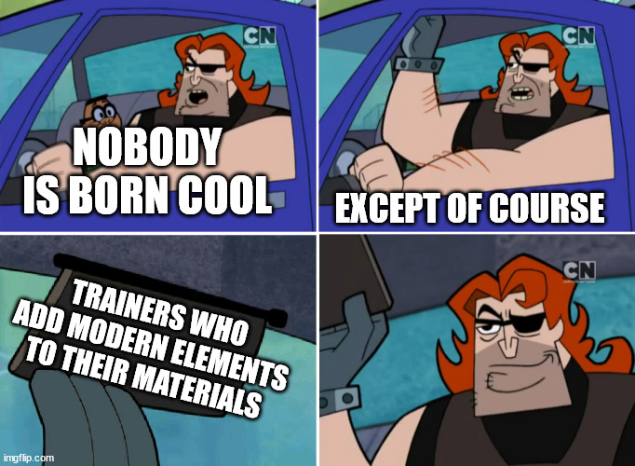
PRO-TIPPS
CANVA is also a great tool to create your own visuals!
www.canva.com
Use free images with no copyright
www.pexels.com
www.pixabay.com
www.unsplash.com
https://commons.wikimedia.org
Use GIFs
https://tenor.com
https://giphy.com
Use or create memes
https://imgflip.com
Use Google to search for a phrase and add „meme“ or „gif“
Memes/GIFs are generally freely available in the public domain!

Slide 29
CREATE, UPLOAD, LIVESTREAM VIDEOS
A brief crash course

Slide 30
MAKING VIDEOS
3 Options:
Livestreaming
Filming (yourself or something)
Animating
Many ways to upload & share videos
Focus now on YouTube
quick and fairly easy
videos & livestreams can be private (when only accessible via shared link)

Slide 31
BECOME A YOUTUBE CREATOR
Create Google/YouTube account (preferebly a new one for the WBL content only)
Go to „YouTube Studio“ to see all options
Click on the „CREATE“ Button
Choose to upload video or livestream
How to upload a video
How to livestream
OBS Studio (free additional software to facilitate streaming)
How to share, analyse and delete videos

Slide 32
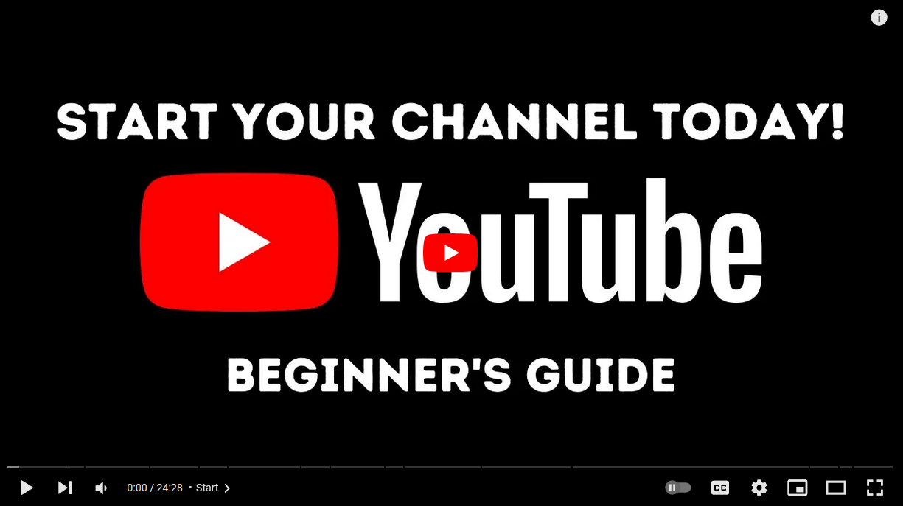
YOUTUBE CHANNEL SETUP

Slide 33
CHOOSE ONLINE ASSESSMENT TOOLS
Have the learners reached the learning goals?

Slide 34
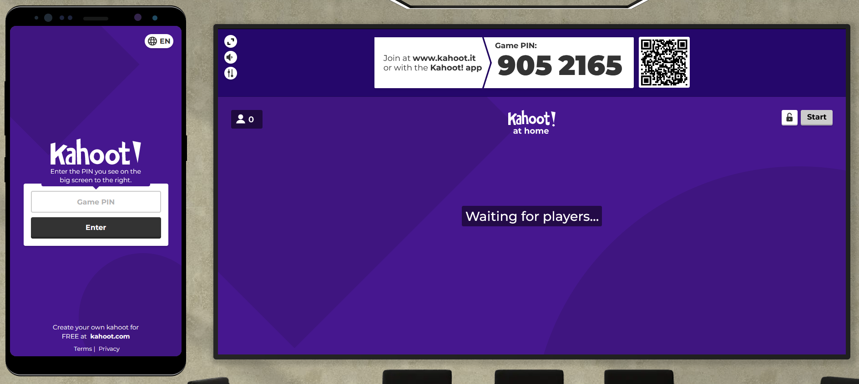
ASSESSMENT METHODS
Try it yourself!
www.kahoot.it
9052165

Slide 35
KAHOOT
HOW DO I CREATE A KAHOOT QUIZ?
Kahoot is an engaging way to test the learning outcomes
It can be implemented in a synchronous group setting as well as asynchronous by individual learners
It can be also used to present learning content directly in the tool!
Mix of learning content & immediate assessment

Slide 36
BRAINSTORM
What other online assessment tools come to your mind?
DISCUSS

Slide 37
VIRTUAL ASSESSMENT TOOLS (EXAMPLES)
Questionnaire System
Survey Monkey
Google Forms
Uploading result / homework
Google Drive
Padlet
Project Management Tools
Meistermind
Trello
Communication Channel
Discord
Forum Free

Slide 38
OUTLOOK ON SDL-PHASE
How can you put everything you have learned into practice?

Slide 39
LOOKING BACK…
What have you learned in Module 1?
What have you learned in Module 2?
What have you learned in Module 3?
What have you learned today in Module 4?
→ How can you put everything into practice?

Slide 40
SELF-DIRECTED LEARNING
Use the self-directed learning phase to digitalise your WBL content by applying the knowledge, skills, and competences acquired in this training.
Choose your WBL content
Create learning outcomes
Create storyboard & call to action
Choose delivery method and create digital WBL content
Choose virtual assessment method and create assessment
Test digital WBL content and collect feedback
You can find all materials from this course here.
Get in touch if you have any further questions!
Notes:
https://www.wbl-goes-virtual.eu/self-directed-learning/

Slide 41
FLASHLIGHT METHOD
Reflecting on the training

Slide 42
FLASHLIGHT METHOD
Let‘s all answer the following questions:
What opportunities have I identified?
What barriers have I identified?
What is the key message I take away with me?

Slide 43
THANK YOU
More information at www.wbl-goes-virtual.eu

